Slide 1

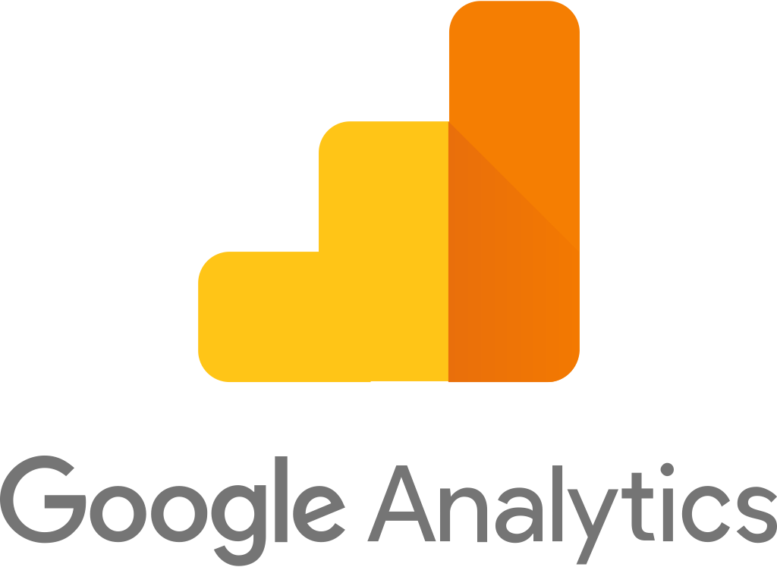

DIGITAL ANALYTICS 4
Group B
Abdulaziz A., Gauchet Van A., Nabil M., Ckalib N., Addison P., Michael W., Sarang Z.

Slide 2



Table of Contents
What is Google Analytics?
What does the 4th generation bring?
GA4 Impacts to GMS
Innovative capabilities
Cookie-less future

Slide 3

What is Google Analytics?

Slide 4

What is Google Analytics?
Google’s Analytics reporting tool is widely used by millions of businesses and websites to track user interaction across web domains, mobile apps, and offline APIs. Most businesses know this platform as the tool that helps them track the amount of web traffic they get, monitor important marketing channels, and to measure their main KPIs. In a nutshell, it enables the users to analyze the following:
WEBSITE TRAFFIC
TRACK CONVERSIONS
Where Visitors Come From and How
They Are Navigating Through Your Websites
Behavior
Downloads
Page Views
Registrations

Slide 5
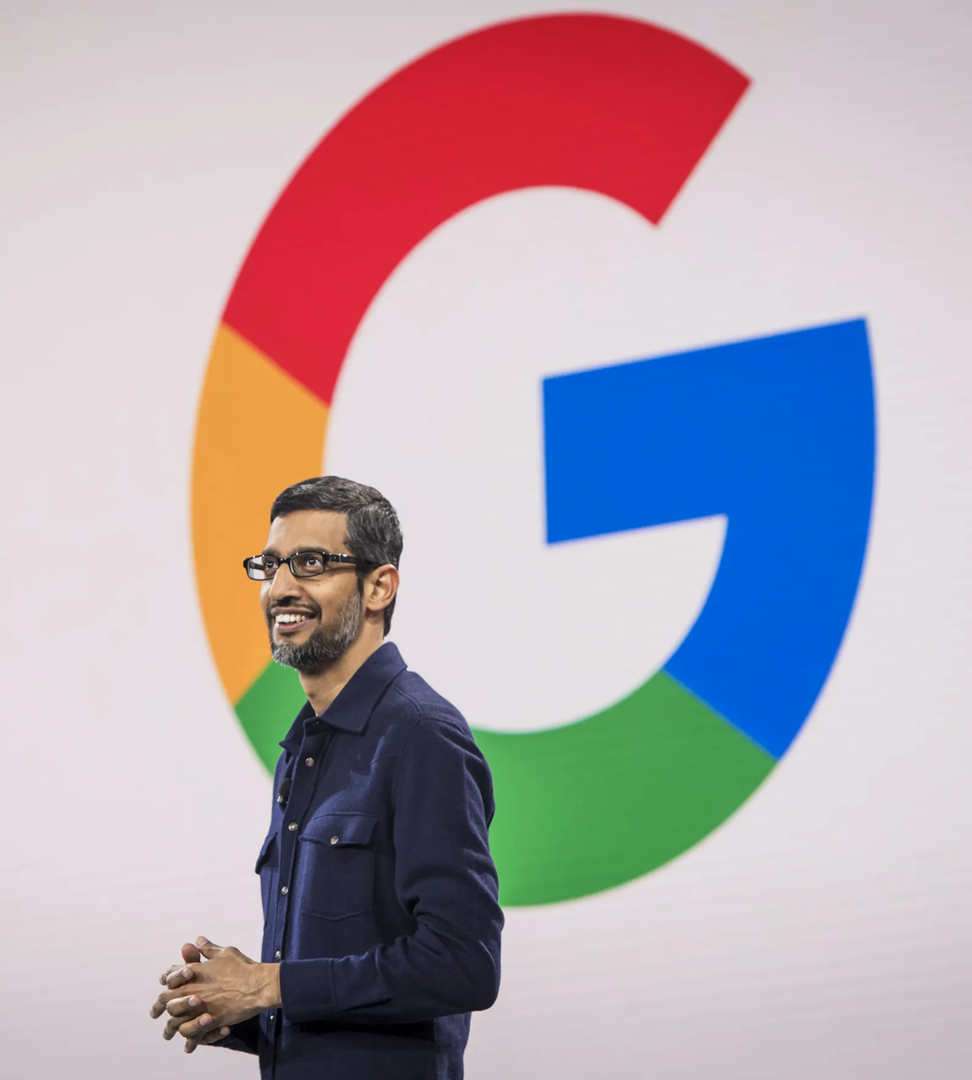

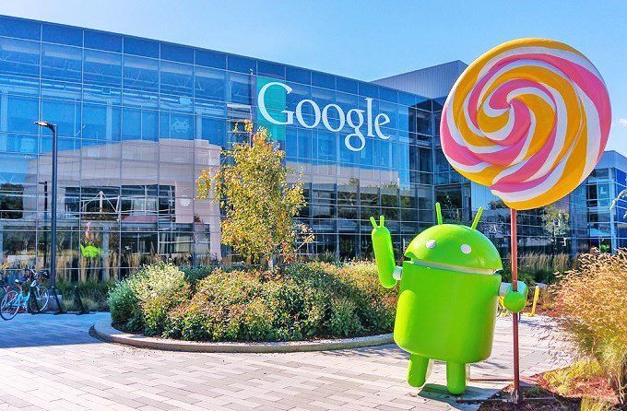

What Does the 4th Generation Bring?

Slide 6







What Does the 4th Gen Bring?
In October 2020, Google released Google Analytics 4 (GA4). Google self-describes the purpose of the new Google Analytics as a next generation approach to “privacy-first” tracking, x-channel measurement, and AI based predictive data all at once. GA4 is all about “events.” These events are the main way that data is presented in the new Google Analytics. Here is summary of highlights:
It’s built with machine learning as the main form of data measurement, using “modeling” that can extrapolate from existing data
Google Analytics 4 features “data streams” instead of the views and segments
It’s designed to be “future proof” and work in a world without cookies or identifying data.
There is no “view” level section of GA4. It only has Account and Property levels.
It’s focused on giving marketers a “more complete understanding of the customer journey across devices.”
Google Analytics 4 claims to enable editing, tracking and fine-tuning of events within the UI.

Slide 7
GA 4th Generation New Capabilities
Cross-domain tracking that does not require code adjustments either, can be done within the UI
GA4 will allow marketers to edit, correct and fine-tune the way events are tracked in their analytics without having to edit on-site code.
1
2
3
4
Data Import can now include a wide range of data from non-website sources (like apps for example) all within one property.
A “Life Cycle Report” which seems to be one of the biggest changes in Analytics and focuses on user journey.

Slide 8

GA4 Impacts to GMS

Slide 9




GA 4 Impacts to GMS
ADVANCED ANALYSIS: The templates for advanced analysis are among the most significant features in Google Analytics 4. In Google Universal Analytics, this capability is available only in the enterprise version of the platform. GA4 opens these up to everyone to further explore data and drill down for deeper insights such as doing funnel analysis, path analysis and line charts with anomaly detections.
ENHANCED SEARCH: The search feature in GA4 returns a variety of results, including insights, built-in reports, and help articles.
ECOMMERCE REPORTS: Ecommerce tracking in GA4 adheres to the fundamental event and parameter model but GA4 still does provide specialized metrics and reporting for Ecommerce
AUTOMATICALLY COLLECTED EVENTS: Google Analytics 4 automatically collects a range of events when implemented for mobile apps and/or web.

Slide 10
Innovative capabilities

Slide 11
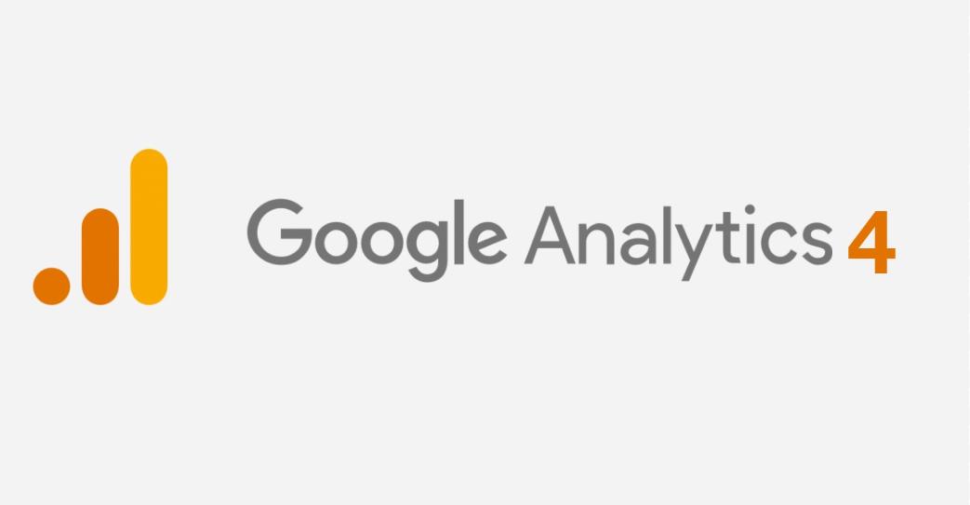
Innovative capabilities
Smarter AI-powered Insights and Predictions
ML is taken even further with GA4, detecting changes in trends related to your offerings and automatically alert you.
1
More Granular Data Control
Deeper Integration with Google Ads
Updates to how data is controlled means you can better manage the collection, retention, and usage of your Analytics data.
4
2
This new integration allows you to create & maintain custom audiences from visitors, and automatically will remove them or add them to new lists as they perform actions on your site.
Customer-Centric Measurements and Customer Life Cycle Reports
3
The new analytics provides a customer-centric measurement to give you a complete view of customer interactions.

Slide 12

Cookie-less future

Slide 13
Background & transition to cookie-less
In January 2020, Google announced its plans ‘to phase out support for third-party cookies in Chrome... within two years’. In two years' time, all major browsers (Google Chrome, Firefox, Safari) will have blocked the use of third-party cookies. This may alter the landscape for digital advertising which currently relies extensively on third-party cookie data for personalization. Businesses need to prepare and adapt
to changes in personalization solutions. However, there is no need to panic.
To remain competitive, Google Analytics has done just that. Google Analytics 4; tracking in a cookie-less world!

Slide 14

Cookies background
Within just the last three years, there have been numerous updates to strengthen the privacy of users on the internet
May 2018
GDPR (European General Data Processing Regulation)
March 2019
ITP2.1 (Apple’s Intelligent Tracking Prevention 2.1)
June 2019
During your presentation, the speaker ETP (Firefox’s Enhanced Tracking Prevention) are visible on your monitor but aren't visible to the audience.
July 2020
2022
Only first party cookies will be allowed
LDU (Facebook’s Limited Data Use Feature)

Slide 15
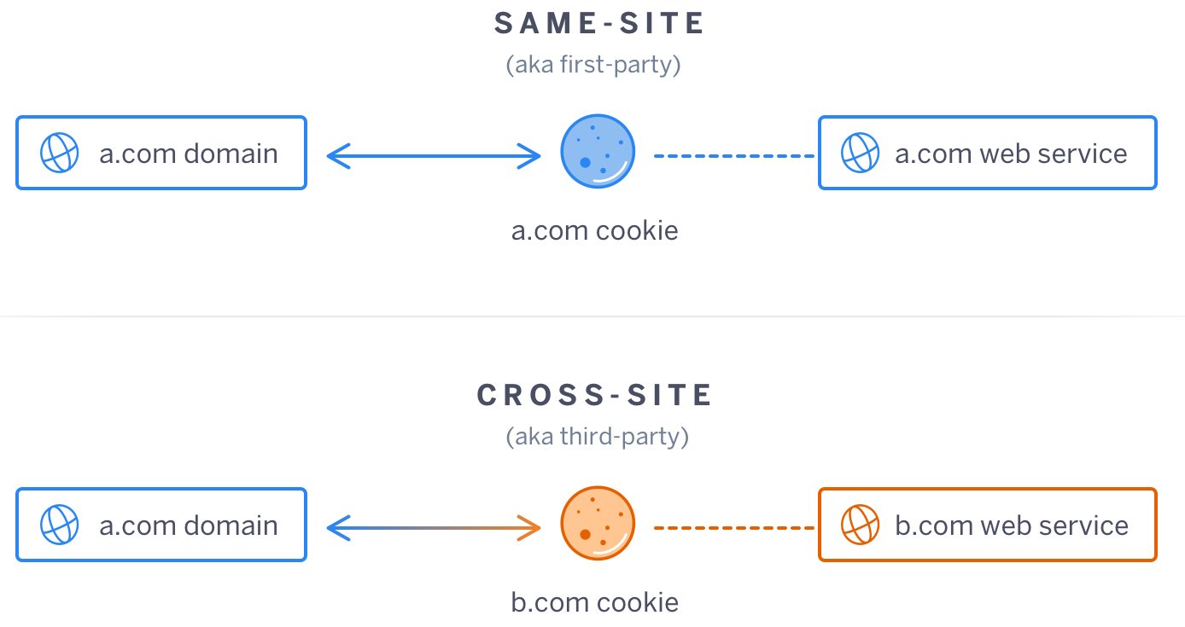

First-Party vs. Third-Party Cookies
2022

Slide 16


Thank You
Group B
Digital Analytics | Francisco Gallego Calonge

